Slide 2
University Student Employment
(non-Federal Work Study )
Student Employment Process Overview
Hiring Managers verify eligibility of funds with the Budget Office
Students and Hiring Managers complete required forms
Hire student or rehire/extend student’s assignment using the appropriate web based system

Slide 3
How do I hire my student(s)?
NEW HIRE
A student that has not worked on campus, or has not worked in the same position in the same department previously
Processed via Human Resources Action Form (HRAF)
Generated in HireTouch
REHIRES/ EXTENSIONS
A student that has already worked in the same position in the same Department previously
Processed via electronic Human Resources Action Form (eHRAF)
Generated in WP Connect

Slide 4
eHRAF – new for Fall 2021!
What is it used for?
eHRAF, located in WP Connect, is designed for Hiring Managers to:
Extend existing student employment assignments
Only to be used for students that have already worked in the same Department and in the same title

Slide 5
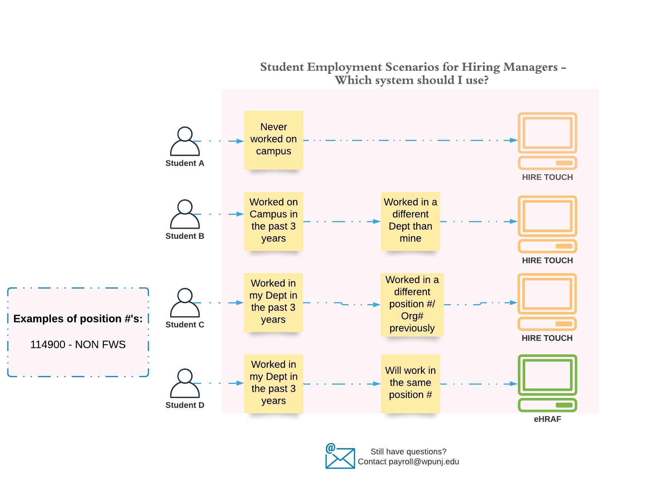
Which system should I use?

Slide 6
Important Reminders
Please be sure when entering the Start and End Date for the HRAF it must fall within the current Fiscal Year
Please refer to the payroll schedule published on our website
Hourly Rate of Pay should be coordinated with the Budget Office
*** Please note that the State Minimum Wage will continue to increase each January until the minimum wage hits $15.00 per hour

Slide 7
Do students get paid sick leave?
Please review the following slides to learn more about the
New Jersey Paid Sick Leave Act (NJ PSLA)

Slide 8
NJ Paid Sick Leave Act (NJPSLA)
Employee Entitlements:
Part time employees begin to accrue paid time off beginning October 29, 2018 or upon hire, whichever is later, under the following terms and conditions:
Employees accrue one hour of paid time off for every thirty (30) hours actually worked.
Employees can earn a maximum of 40 hours of paid time off over a 12 month “benefit year”. William Paterson University’s benefit year commences on July 1 and ends June 30.
Employees may carry over any earned but unused paid sick leave balance into the next year but are limited to 40 hours per benefit year.
Employees are not entitled to any payout for accumulated but unused paid time off upon separation voluntarily or involuntarily. If the employee is reinstated by the University within 6 months of the separation date, then all of the employee’s unused sick time will be reinstated.

Slide 9
NJ Paid Sick Leave Act (NJPSLA)
Employees can use earned sick leave:
For diagnosis, care, treatment of, recovery from their own or their family member’s mental or physical illness, injury, or other adverse health condition or for preventative medical care;
For treatment/counseling/services for domestic or sexual violence in connection with themselves or family member;
For closure of employee’s workplace or child’s school/care by order of public officials, or presence of them/family member in community would jeopardize health of others; and
To attend a school-related conference, meeting, function or other event requested or required by child’s school or regarding care of child’s health condition.
For more information:
https://www.nj.gov/labor/earnedsick/

Slide 10
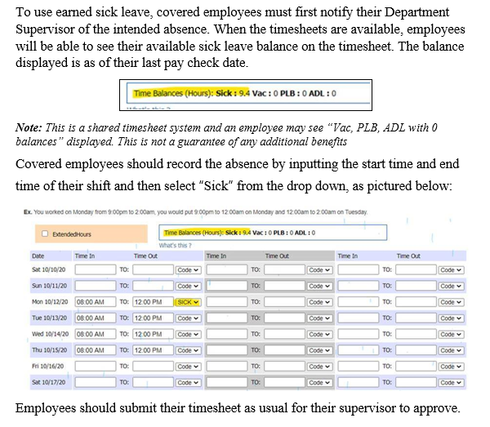
NJ Paid Sick Leave Act (NJPSLA)

